Slide 1
Photo Background Remove
Present By:-
DHRUMIL N. KARIA
ATIK SHAIKH

Slide 2
Index
Introduction
Literature review
Problem statement
Proposed work
Results
Conclusion
Future work
References

Slide 3
Introduction
Photo background removal is a digital image processing technique that involves isolating the main subject of a photo by removing or changing its background.
That technology has quickly found its niche and utility in not just e-commerce, but also photography, graphic design, machine learning and other domains.
Background removal is another important preprocessing step in computer vision applications.
Removing irrelevant features enables models to concentrate on the essential object, incrementally enhancing performance in fundamentals like object detection, classification, or recognition.

Slide 4
Modern Approaches
Automated Solutions: Modern solutions leverage machine learning (ML) and computer vision techniques, including convolutional neural networks (CNNs) and generative adversarial networks (GANs), to automate the process with remarkable accuracy.

Slide 5
Literature review
Paper-1 U-Net: Convolutional Networks for Biomedical Image Segmentation
Paper-2 Deep Lab: Semantic Image Segmentation with Deep Convolutional Nets
Paper-3 MODNet: Trimap-Free Portrait Matting in Real Time
Paper-4 RefineNet: Multi-Path Refinement Networks for High-Resolution Semantic Segmentation
Paper-5 GrabCut: Interactive Foreground Extraction Using Iterated Graph Cuts

Slide 6
Paper – 1
U-Net: Convolutional Networks for Biomedical Image Segmentation
This paper introduces a convolutional neural network known as U-Net for biomedical image segmentation.
The network has key features that include a U-shaped architecture with a contracting path to capture context and an expanding path for accurate localization.
Data augmentation, especially elastic deformations, are used by the network to learn from limited training data.
U-Net achieves state-of-the-art performance in segmentation tasks, including neuronal structures in electron microscopy and cells in light microscopy, outperforming previous methods.
It is computationally efficient, with the ability to process large images quickly and seamlessly using minimal annotated samples.
The design and training strategies make U-Net widely applicable in biomedical image analysis.

Slide 7
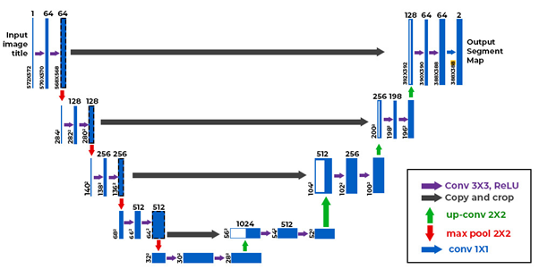

Slide 8
Paper – 2
MODNet: Trimap-Free Portrait Matting in Real Time
MODNet breaks down matting into three sub-objectives: semantic estimation, detail prediction, and semantic-detail fusion.
Efficient Atrous Spatial Pyramid Pooling (e-ASPP): The approach reduces the computational overhead while efficiently fusing multi-scale features.
Self-supervised Sub-objective Consistency (SOC): The method handles domain shift problems, and thus enhances performance on real-world data without the need for labeled samples.
Achieves the state-of-the-art result on benchmarks such as Adobe Matting Dataset (AMD) and the newly proposed Photographic Portrait Matting (PPM-100).
The proposed method performs better than existing trimap-free methods in terms of accuracy and efficiency, showing robustness across various datasets and real-world scenarios.

Slide 9
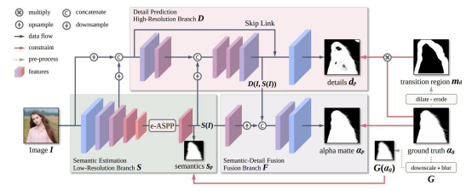

Slide 10
Paper – 3
RefineNet: Multi-Path Refinement Networks for High-Resolution Semantic Segmentation
RefineNet, a multi-path refinement network for high-resolution semantic image segmentation.
This allows for a stronger fusion between high-level semantic and fine-grained low-level features, which can be limited in the traditional convolutional neural networks due to the intrinsic resolution loss.
RefineNet uses long-range residual connections and chained residual pooling towards accuracy and end-to-end training.
It sets new log records on seven public datasets, such as PASCAL VOC 2012 and Cityscapes.

Slide 11
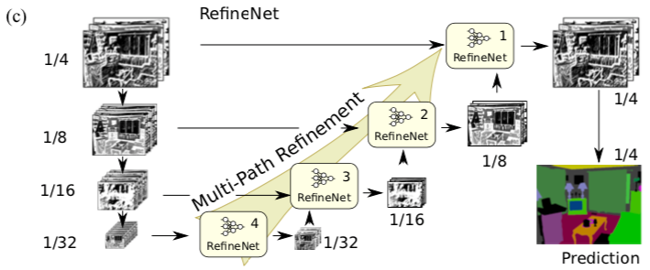

Slide 12
Paper – 4
GrabCut: Interactive Foreground Extraction Using Iterated Graph Cuts
GrabCut is an interactive image segmentation tool developed to efficiently extract the foreground from a still image.
This method improves upon the traditional Graph Cut segmentation by introducing iterative optimization, simplifying user interaction, and refining results with border matting to handle transparency and complex boundaries.
GrabCut offers a user-friendly, efficient, and powerful tool for interactive foreground extraction in image editing.
By combining iterative graph cuts and border matting, it produces high-quality results with minimal user input, making it a valuable asset for digital image processing.
GrabCut outperforms existing tools in terms of ease of use and quality of results, especially for images with complex backgrounds.

Slide 13
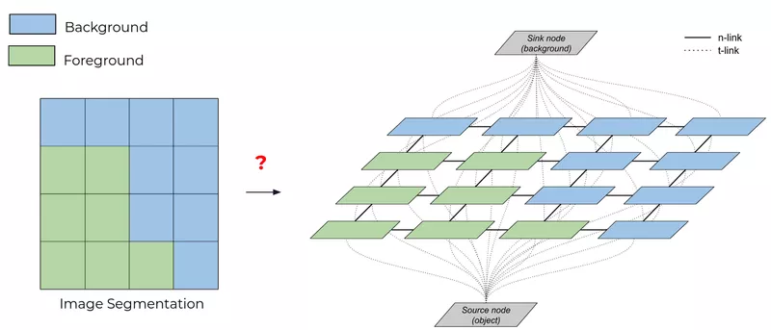

Slide 14
Paper – 5
Deep Lab: Semantic Image Segmentation with Deep Convolutional Nets
we present DeepLab, a DCNN-based approach for semantic image segmentation.
At the same time, this work provides solutions for the feature resolution reduction problem and the object boundary localization issue over the use of atrous convolution, atrous spatial pyramid pooling (ASPP), and fully connected CRFs.
Atrous Convolution: Maintains resolution while expanding the field of view for feature extraction.
Atrous Spatial Pyramid Pooling (ASPP): Captures context at multiple scales for robust segmentation.
Used as post-processing to improve object boundary, localization and refine segmentation results.
Combines DCNN outputs with CRFs for better accuracy and fine detail capture.

Slide 15
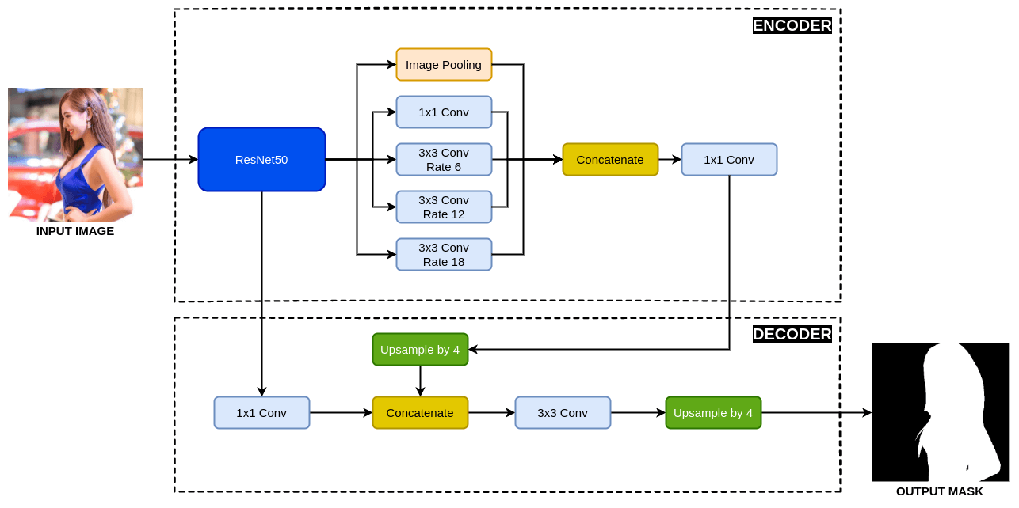

Slide 16
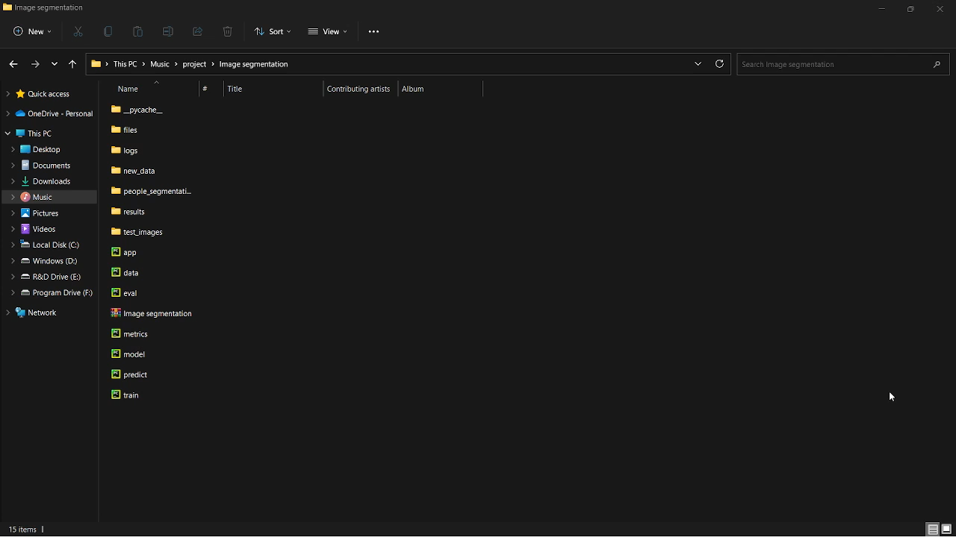

Slide 17

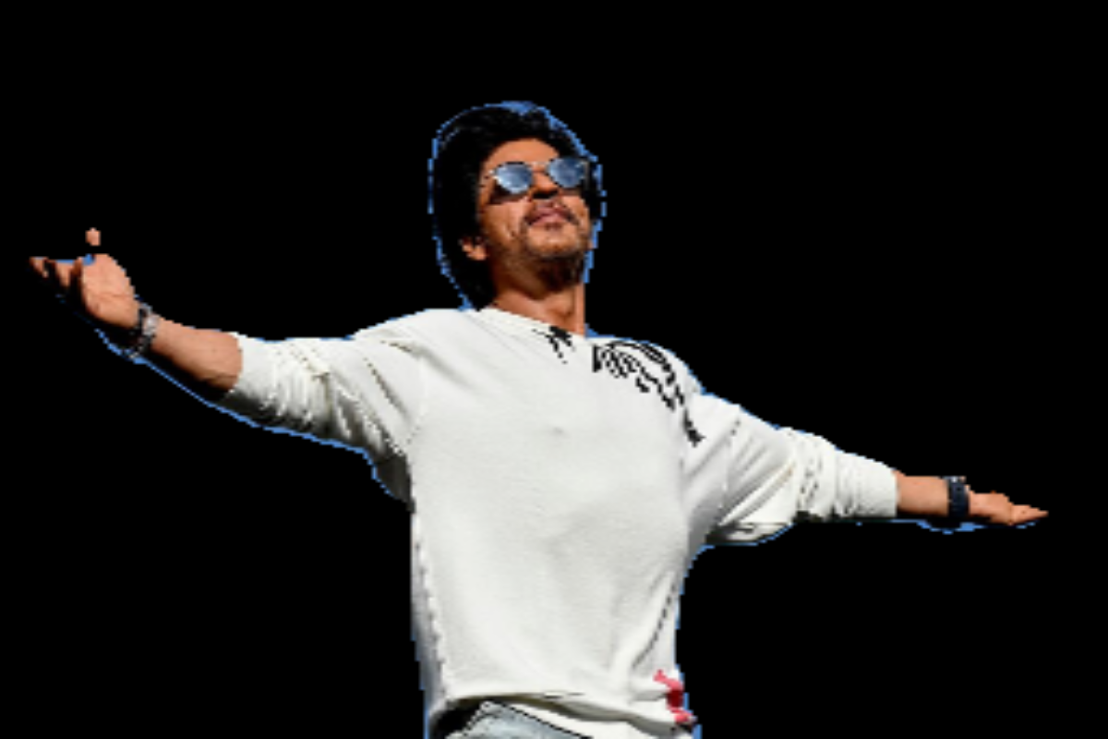
Result
Original Image
Background Remove Image

Slide 18
Problem Statements
To develop an algorithm or system that can accurately and efficiently isolate and remove the background from a digital image, leaving only the foreground subject intact, while handling complex features like hair, fine details, and irregular object boundaries, to enable seamless integration of the subject into different backgrounds.
Although performing computer vision and machine learning has made great strides, photo background removal remains a non-trivial task, based on the following reasons.
Complex Backgrounds:
The images are cumbersome with many similar components with colors and textures alike to those in the foreground.
Fine Detail Preservation:
It becomes increasingly difficult to preserve fine details (e.g., hair strands, fur, and transparent objects) without having jagged and inaccurate edges of either side.

Slide 19
Problem Statements
Scalability and Efficiency:
Utility models for real-time applications like Video Processing/Augmented-Reality or other use cases with low compute resources.
Ability to generalize two different images:
Lighting conditions, resolution, and type of subject to demand strong algorithms which can manage a great variety of image types.
High Computational Cost:
Conventional approaches and complicated neural networks need high computing power, which makes them intractable for low-powers devices.

Slide 20
Proposed Work
The proposed work involves developing an efficient and robust photo background removal system leveraging advanced machine learning and computer vision techniques.
steps include:
Data Collection: Building a diverse dataset of images with complex backgrounds and fine details like hair and fur.
Algorithm Design: Using models like DeepLab V3 and RestNet50, the algorithm will focus on high-accuracy segmentation with attention to fine detail preservation.
Implementation: Developing a system that can generalize across various image types, maintaining efficiency on low-power devices.
Evaluation: Testing the system on benchmarks for scalability, precision, and computational efficiency.

Slide 21
Conclusion
Photo background removal is a critical task in image processing with applications in diverse domains. While modern techniques have made remarkable progress, challenges like complex backgrounds and fine detail preservation remain. The proposed approach aims to address these gaps by developing an efficient, accurate, and generalizable solution that meets the needs of both high-end and low-power devices.

Slide 22
Future work
Improved Detail Preservation
Develop advanced techniques to handle transparent and semi-transparent objects (e.g., glass, water).
Real-Time Performance
Optimize algorithms for real-time applications, including video background removal and augmented reality.
Cross-Domain Generalization
Extend the system's capabilities to perform consistently across varied image resolutions, lighting conditions, and subjects.
Integration with AR/VR
Explore integration with augmented reality (AR) and virtual reality (VR) systems for immersive applications.
Low-Resource Adaptation
Adapt the algorithms to work efficiently on devices with limited computing power, like smartphones and IoT devices.

Slide 23
References
Ronneberger, O., Fischer, P., & Brox, T. (2015). U-Net: Convolutional Networks for Biomedical Image Segmentation.
Chen, L.-C., Papandreou, G., Kokkinos, I., Murphy, K., & Yuille, A. L. (2017). DeepLab: Semantic Image Segmentation with Deep Convolutional Nets.
Ke, Z., Sun, J., & Zheng, H. (2020). MODNet: Trimap-Free Portrait Matting in Real-Time.
Lin, G., Milan, A., Shen, C., & Reid, I. (2017). RefineNet: Multi-Path Refinement Networks for High-Resolution Semantic Segmentation.
Rother, C., Kolmogorov, V., & Blake, A. (2004). GrabCut: Interactive Foreground Extraction Using Iterated Graph Cuts.

Slide 24
Any Questions?

Slide 25
Thank You

